Slide 1
Healthcare Analysis

Slide 2
Business Problem
The increase in Heart disease and Hypertension is continuously growing and as such an analysis on what causes the two is needed.
Identifying patterns in the patients that have these conditions will be helpful in reducing the number of people who develop the conditions.

Slide 3
Healthcare dataset
About the dataset
The dataset use here is of over 17 000 patients. It contains factors such as age, BMI, type of job, glucose levels, and other details for the patients. It originally had 11 columns and 18000 rows
The data was collected from Hospital database.

Slide 4
Approach
The dataset was collected the following source:
Healthcare database
Tools used for Analytics:
Excel, Power Bi
Data processing
In excels I removed rows with missing information, but replaced missing cells with over 5000 rows.
On Power BI I created additional measure for KPIs, and created age bins, and other categorical values.

Slide 5
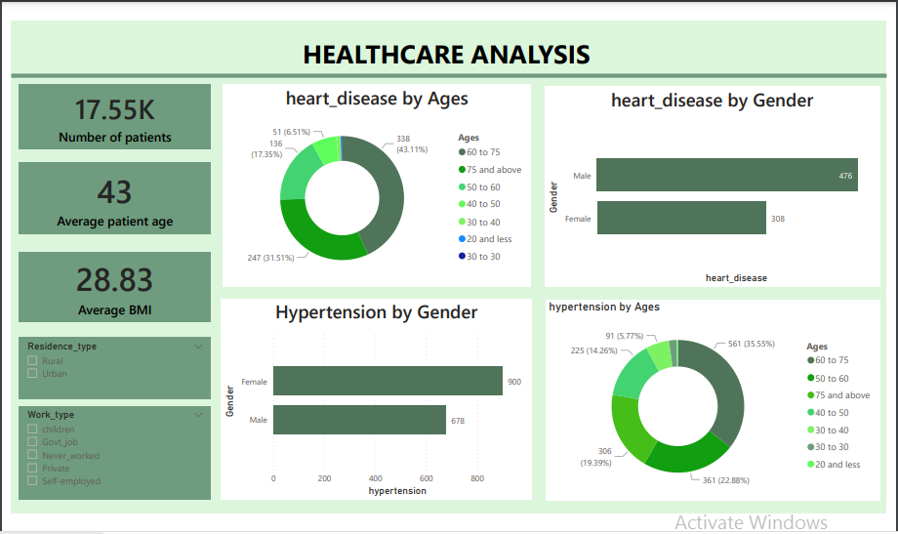
HEALTHCARE ANALYSIS OVERVIEW

Slide 6
Data labeling
There are levels to both Body Mass Index(BMI) and Glucose levels and I have created bins for these levels. They are as follows
BMI Levels | Glucose Levels
Below 18.5 is Under weight | >53 is Severe Hypoglycemia
18.5 to 24.9 I Normal weight | >70 is Hypoglycemia
25.0 to 29.9 is Over weight | >125 is Normal
30.0 to 40 is Obese | >200 is High
40.0 to 50 is Obese level 2 | <200 is Extremely High
60 and above is Extremely obese

Slide 7
Analysis breakdown
About 4.5% of the patients have Heart disease and about 10% have Hypertension.
Of the 4.5%, the males are 61% of this statistic, while females are at 49% and of the 10%, the females are at 57% of the statistic.
The age group with the highest number of people suffering from Heart disease is between 60 to 75 years, second to it is people who are 75 years and above. The other age groups below forty are less than 15% of these statistics above.
Again for Hypertension, the age group between 60 to 75 amount to 35.55% of people suffering from Hypertension. According to World Health Organization ages over 65 are likely to get hypertension.
There are behavioral factors that can be associated with these conditions, like smoking, being overweight, etc.

Slide 8
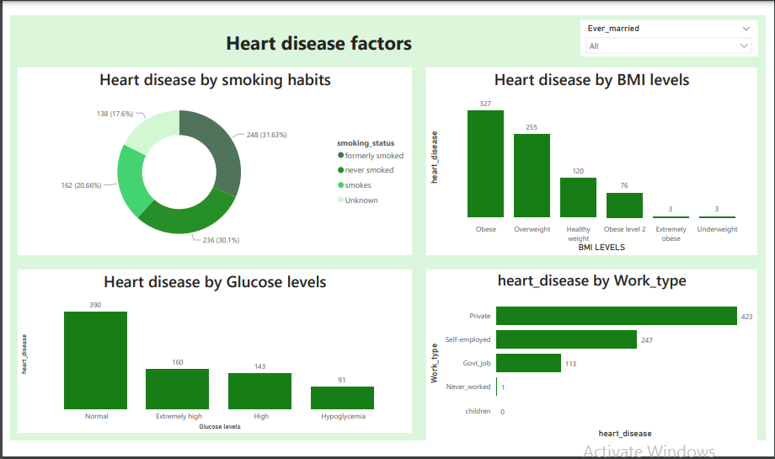
Heart disease factors

Slide 9
Heart condition factors
50% of patients have previously smoked and this has an effect on the heart condition. There is an almost 50/50 chance.
While women are at high risk of getting hypertension, males are at high risk of getting heart condition.
According to World Health Organization, “The most important behavioural risk factors of heart disease and stroke are unhealthy diet, physical inactivity, tobacco use and harmful use of alcohol. The effects of behavioural risk factors may show up in individuals as raised blood pressure, raised blood glucose, raised blood lipids, and overweight and obesity.”
Again stress level from demanding jobs is also a huge contributor to Heart condition. Also married people are more than 80% of the statistic.

Slide 10
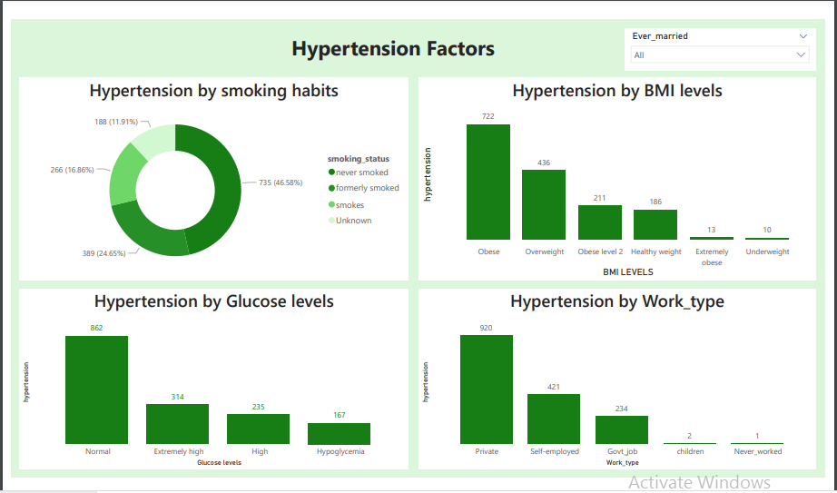
Hypertension Factors

Slide 11
Hypertension factors
According to World Health Organization, factors like unhealthy diet, physical inactivity, consumption of tobacco and alcohol, and being overweight or obese are contributors to hypertension.
High stress levels from a demanding job can be a contributing factor to hypertension. Patient who are in the private sector tend to have high stress levels due to their demanding jobs, this also applies to self-employed individuals.
It’s strange how 46,6% of people who never smoked is the higher portion of the patients with hypertension, because tobacco is one big contributing factor to hypertension. On the other end, this means non-smokers are not completely protected to this illness.
Being overweight is a strong influence on Hypertension. Even though the highest percentage is obese level, other levels beyond that are extremely dangerous too.
Married life seems to be quite a trigger to hypertension. Stress, unhealthy lifestyle might be some of the things married people are prone to.

Slide 12
RECOMMENDATIONS
From the factors listed by WHO, good recommendations would be actions to counter these, like having a healthy diet(with less fat, more fruit and vegetables, and ), regular exercise, less consumption and even stop consuming alcohol and tobacco, and staying within the healthy body weight.
People need to spend money on activities that relieve stress like vacations, especially the married ones and those with demanding jobs. Taking time to relax is just as important as the job itself. No health, no money.
Both conditions seem to be similar on most things like BMI levels, glucose levels, Work type, and others. The likely hood of getting Hypertension is also high for someone with Heart disease, specifically hypertensive heart disease. Getting all the above mentioned points might r
Checking family condition history is highly important, because hypertension can be hereditary, and also some heart diseases run in the family too. Knowing preventative measure and regular check ups is important.

Slide 13
References
https://www.who.int/news-room/fact-sheets/detail/hypertension

